Slide 1
Topic: Graphing EQ: What is appropriateness of scale in column Graphs?
Mrs Parlevliet
Year 11 Essentials

Slide 2
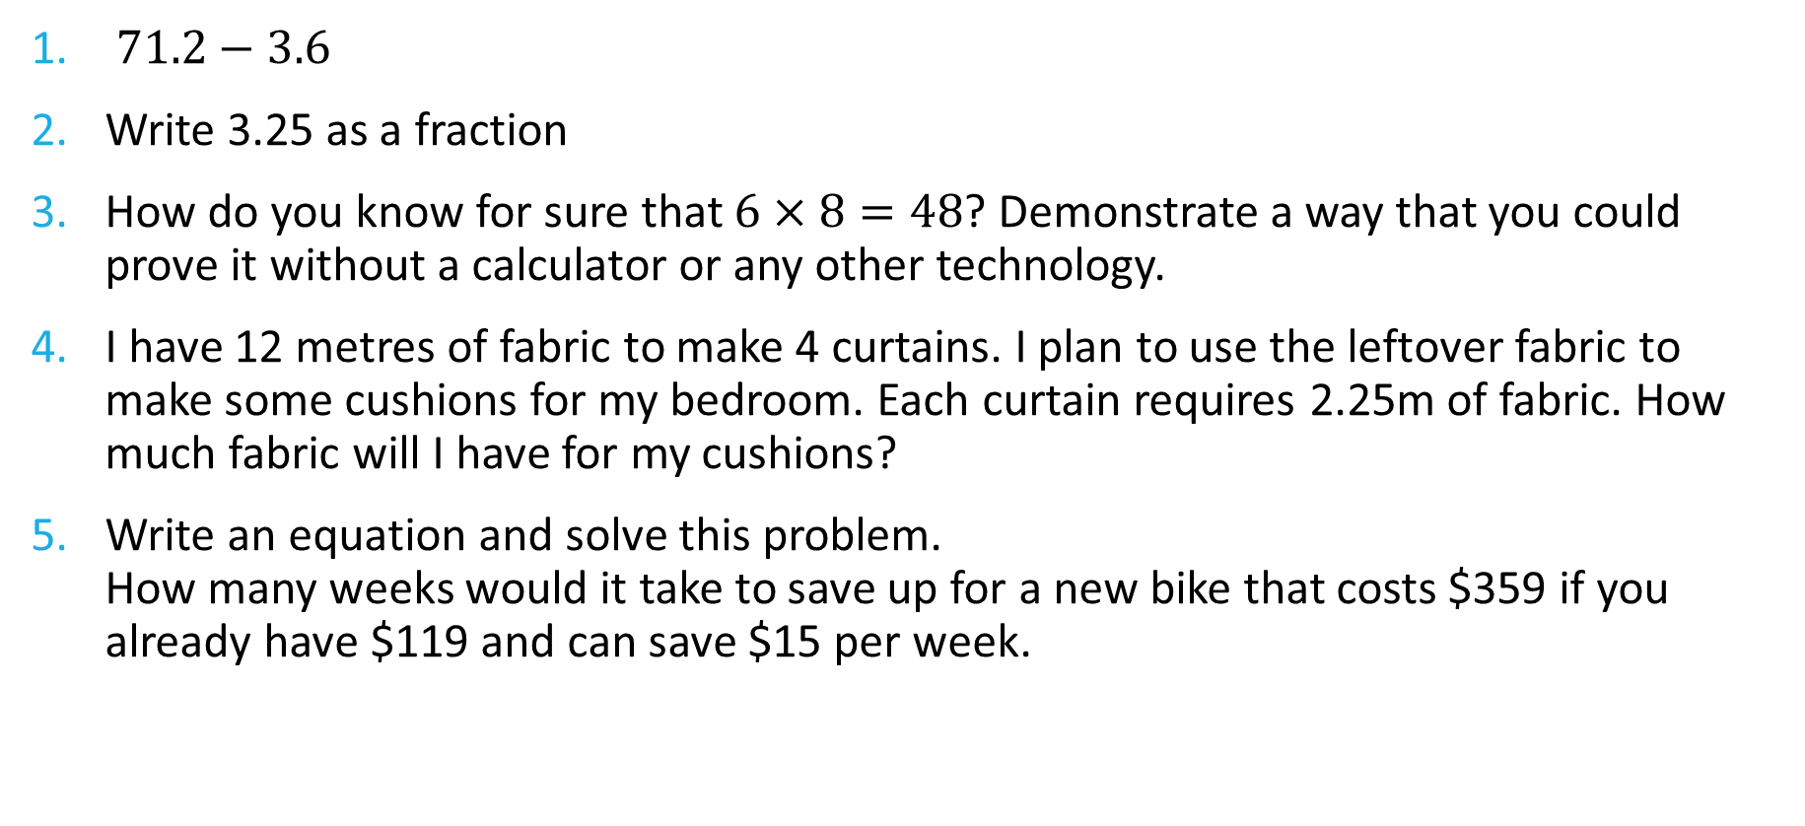
FiVe Questions
Topic: Graphing
Date: XX/XX/2021
EQ – What is appropriateness of scale in column graphs?
$71.2−3.6$
Write 3.25 as a fraction
How do you know for sure that $6×8=48$? Demonstrate a way that you could prove it without a calculator or any other technology.
I have 12 metres of fabric to make 4 curtains. I plan to use the leftover fabric to make some cushions for my bedroom. Each curtain requires 2.25m of fabric. How much fabric will I have for my cushions?
Write an equation and solve this problem. How many weeks would it take to save up for a new bike that costs $359 if you already have $119 and can save $15 per week.

Slide 3
Misleading graphs video
While watching the video:
List the features that help interpreting information from a graph
When might a graph show misleading information?
List as many of these examples
After watching the video be prepared to share your answers with the people around you in preparation for a whole class discussion

Slide 4

https://www.youtube.com/watch?v=E91bGT9BjYk

Slide 5
24
7
30
Topic: Graphing
Date: XX/XX/2021
EQ – What is appropriateness of scale in column graphs?
When graphs are being constructed we need to consider:
The type of data, (Is it numerical data or is it categorical data?)
If numerical data is the data discrete data or continuous data?
The type of scale used to depict the information
What do I need to consider when constructing graphs?
WICOR

Slide 6
Comparison of Two Graphs
Questions
What information does each graph show?
Which graph is depicts the number of cases better for comparing number of cases in each country and why?
How have the different scales affected the display of data?
Notes:
Number of confirmed COVID-19 cases in the 10 most affected countries as at 25th of July 2021
The graph with the linear scale
Differences between millions and 10s of millions can easily be seen
Any other reasonable answer
Linear allows for the visual representation of the difference between millions and 10s of millions and displays the difference in the number of cases between countries clearly. The logarithmic scale implies that the number of cases in each of the 10 most affected countries are similar when they are not.

Slide 7
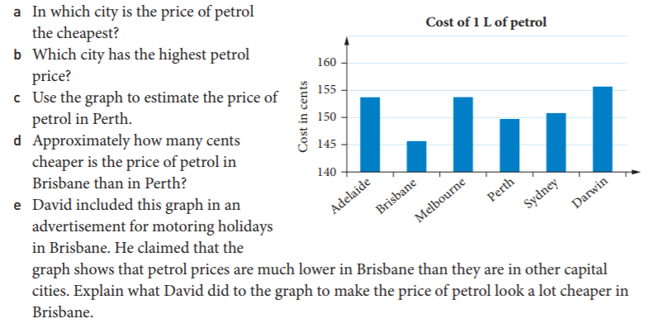
TASK – Appropriate scale worksheet
Question 1
David drew a column graph to show the average cost of petrol in six capital cities.

Slide 8
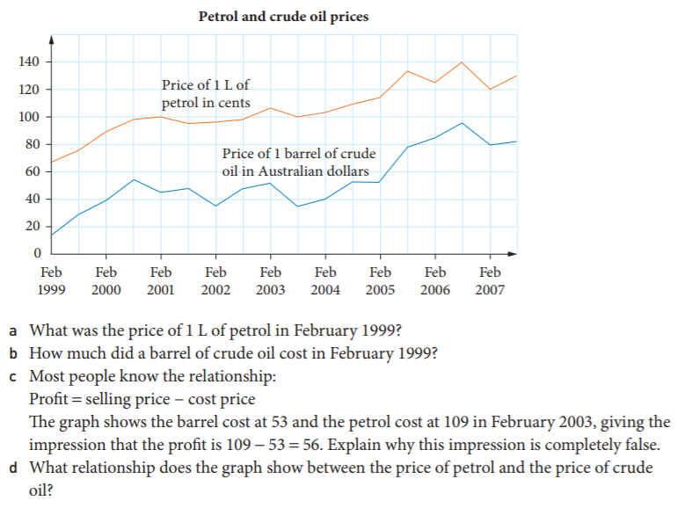
TASK – Appropriate scale worksheet
Question 2
Scott thinks that oil companies are ripping people off. He decided to investigate the price of petrol and the cost of crude oil.
Scott displayed his information on a graph.

Slide 9
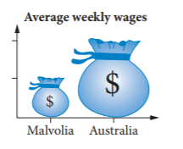
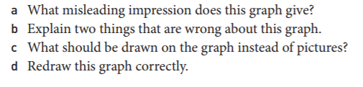
TASK – Appropriate scale worksheet
Question 3
This graph compares the average weekly wages in Malvolia ($700) and Australia ( $1400)

